Slide 1
Lecture 8, 9, 10, 11
CAPTURING REQUIREMENTS

Slide 3
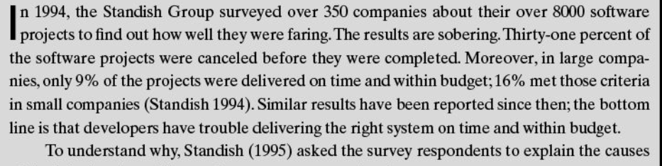

Slide 4
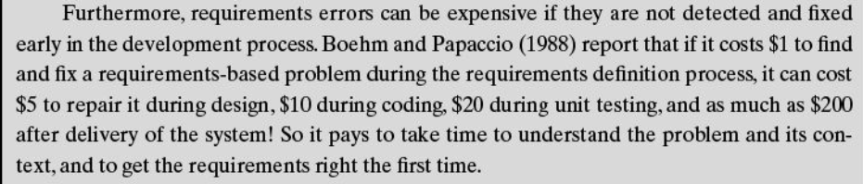

Slide 6
The Requirements Process
A requirement is an expression of desired behaviour
Requirements focus on the customer needs, not on the solution or implementation
designate what behaviour, without saying how that behaviour will be realized

Slide 7
The Requirements Process Sidebar: Why Are Requirements Important?
Top factors that caused project to fail
Incomplete requirements
Lack of user involvement
Unrealistic expectations
Lack of executive support
Changing requirements and specifications
Lack of planning
System no longer needed
Some part of the requirements process is involved in all of the causes
Requirements error can be expensive if not detected early

Slide 8
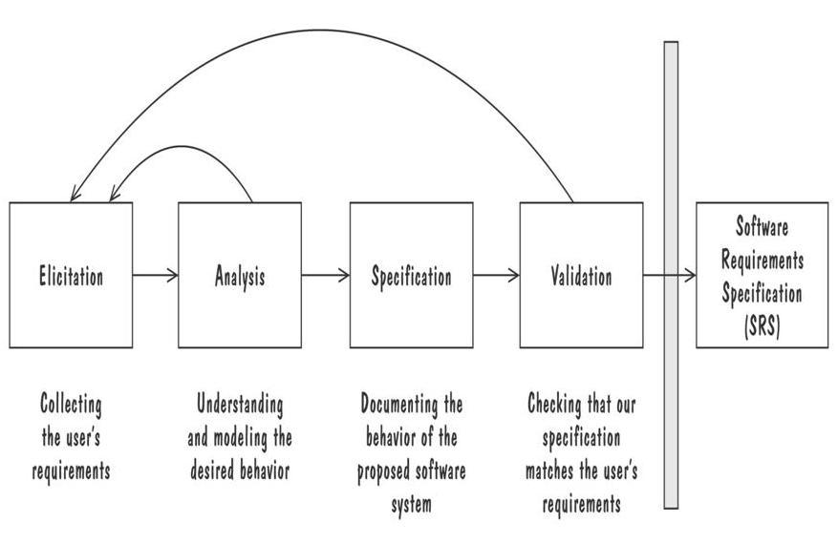
The Requirements Process
Performed by the req. analyst or system analyst
The final outcome is a Software Requirements Specification (SRS) document
Process for Capturing Requirements

Slide 9
Requirements Elicitation
Customers do not always understand what their needs and problems are
It is important to discuss the requirements with everyone who has a stake in the system
Come up with agreement on what the requirements are
If we cannot agree on what the requirements are, then the project is doomed to fail

Slide 10
Requirements Elicitation
Different Stakeholders are:
Clients: pay for the software to be developed
Customers: buy the software after it is developed
Users: use the system
Domain experts: familiar with the problem that the software must automate
Market Researchers: conduct surveys to determine future trends and potential customers
Lawyers or auditors: familiar with government, safety, or legal requirements
Software engineers or other technology experts

Slide 11


Slide 12
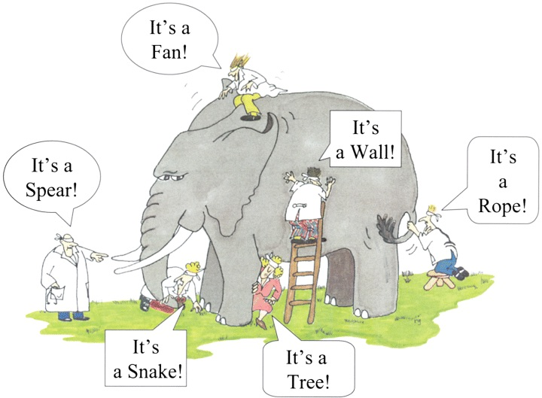

Slide 13
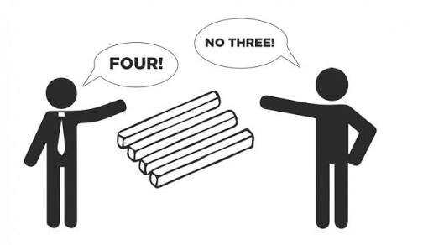

Slide 14
Requirements Elicitation Sidebar: Using Viewpoints to Manage Inconsistency
No need to resolve inconsistencies early in the requirements process (Easterbrook and Nuseibah, 1996)
Stakeholders' views documented and maintained as separate Viewpoints through the software development process
The requirements analyst defines consistency rules that should apply between Viewpoints
The Viewpoints are analyzed to see if they conform to the consistency requirements
Inconsistencies are highlighted but not addressed until there is sufficient information to make informed decision

Slide 15
Requirements Elicitation
Means to Elicit Requirements:
Interviewing stake holders
Reviewing available documentations
Observing the current system (if one exists)
Apprenticing with users to learn about user's task in more details
Interviewing user or stakeholders in groups
Using domain specific strategies, such as Joint Application Design, or PIECES
Brainstorming with current and potential users

Slide 16
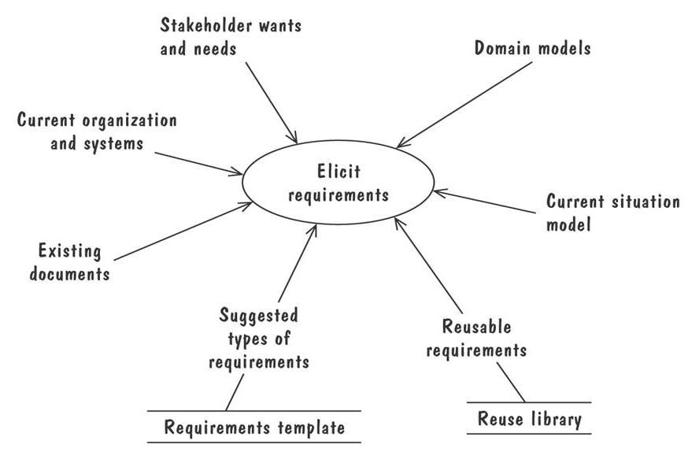
Requirements Elicitation
The Volere requirements process model suggests some additional sources for requirements

Slide 17
Types of Requirements
Functional requirement
Describes: interaction between the system and its environment, how should the system behave given certain stimuli, required behaviour in terms of required activities
Example: For a system of printing pay cheques the functional requirements must answer the following:
When are pay cheques issued?
What input is necessary for a pay cheque to be printed?
Quality requirement or non-functional requirement
Describes: some quality characteristic that the software must posses, a restriction on the system that limits our choices for constructing a solution
Constraints could be:
Design constraint: a design decision such as choice of platform or interface components
Process constraint: a restriction on the techniques or resources that can be used to build the system
Example: queries to the system must be answered within 3 seconds
Both types of requirements are elicited from the customer in a formal, careful way.

Slide 18
Types of Requirements
Two kinds of Requirement Documents
Requirements definition: a complete listing of everything the customer wants to achieve
Describing the entities in the environment where the system will be installed
Requirements specification: restates the requirements as a specification of how the proposed system shall behave
Primarily used by our technical team

Slide 19
Prioritizing Requirements
Different stakeholder has different set of requirements
potential conflicting ideas
Need to prioritize requirements to resolve conflicts
Prioritization might separate requirements into three categories
essential: absolutely must be met
desirable: highly desirable but not necessary
optional: possible but could be eliminated

Slide 20
Lecture 9

Slide 21
Characteristics of Requirements
Correct
Consistent
Unambiguous
Complete
Feasible
Relevant
Testable
Traceable

Slide 22
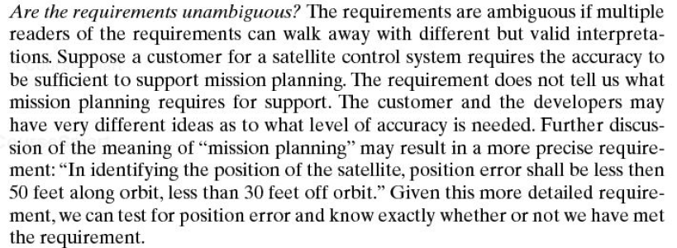

Slide 23

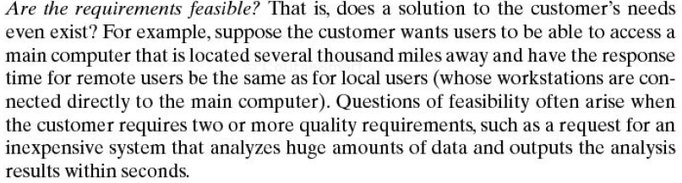

Slide 26
Testable Requirements
Testable/Measurable Requirement:
Objective description of the requirement’s meanings
All possible entities and activities can be examined and classified as Meet Requirements and Do Not Meet Requirements
Testable requirements are helpful in making good design
Requirements that are not testable are likely to be ambiguous, incomplete and incorrect

Slide 27
Testable Requirements
Robertson and Robertson suggest 3 ways to help make requirements testable:
Specify a quantitative description for each adverb and adjective
Replace pronouns with specific names of entities
Make sure that every noun is defined in exactly one place in the requirements document

Slide 28
Testable Requirements
Some examples:
Not Testable: Water quality information must be accessible immediately
Testable: Water quality information must be retrieved within five seconds of request
Not Testable: The system should handle a large number of users at a time
Testable: The system should handle 5000 users at a time
Not Testable: User should press the Save button when writing text in the system. This prevents it from being lost.
Testable: User should press the Save button when writing a note in the system. Pressing the Save button prevents the text from being lost.

Slide 29
Expressing Requirements
A requirement deals with
objects or entities
the state they can be in
functions that are performed to change states or object characteristics
It is important to have standard notations for modelling, documenting, and communicating decisions
Modelling helps us to understand requirements thoroughly
Holes in the models reveal unknown or ambiguous behaviour
Multiple, conflicting outputs to the same input reveal inconsistencies in the requirements

Slide 30
Expressing Requirements
Dynamic Descriptions of a System
Decision Tables
State Diagrams (Statecharts)
Fence Diagrams
Event Tables
Petri Nets
Event Traces (Message Sequence Charts)
Static Descriptions of a System
Object Models (ER Diagrams, Abstract class diagrams)
Other Techniques to Express Requirements
Data Flow Diagrams (DFD)
Usecase Diagrams

Slide 31
Decision Tables
It is a tabular representation of a functional specification that maps events and conditions to appropriate reponses or action
The specification is formal because the inputs (events and conditions) and outputs (actions) may be expressed in natural language
If there is n input conditions, there are 2^{n} possible combination of input conditions
Combinations map to the same set of result can be combined into a single column

Slide 32
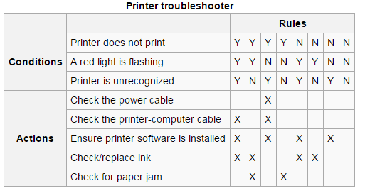

Slide 33
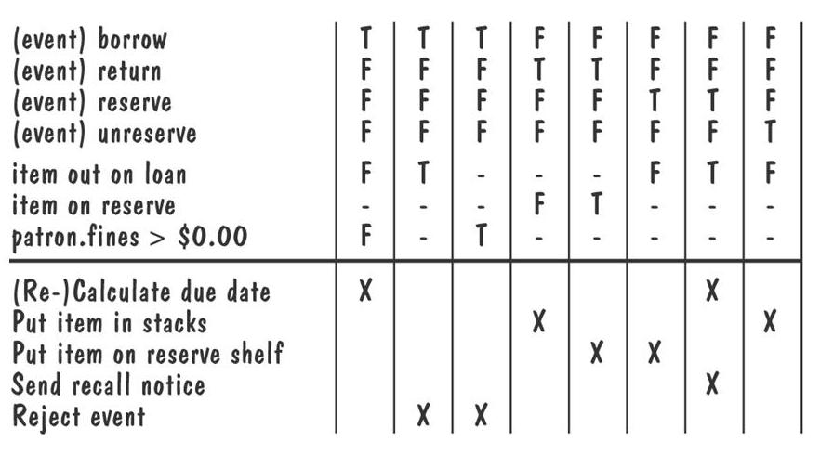
Decision Tables (Contd.)
Decision table for library functions borrow, return, reserve, and unreserve

Slide 34
State Diagrams
A graphical description of all dialog between the system and its environment
Node (state) represents a stable set of conditions that exists between event occurences
Edge (transition) represents a change in behavior or condition due to the occurrence of an event
Useful both for specifying dynamic behavior and for describing how behavior should change in response to the history of events that have already occurred

Slide 35
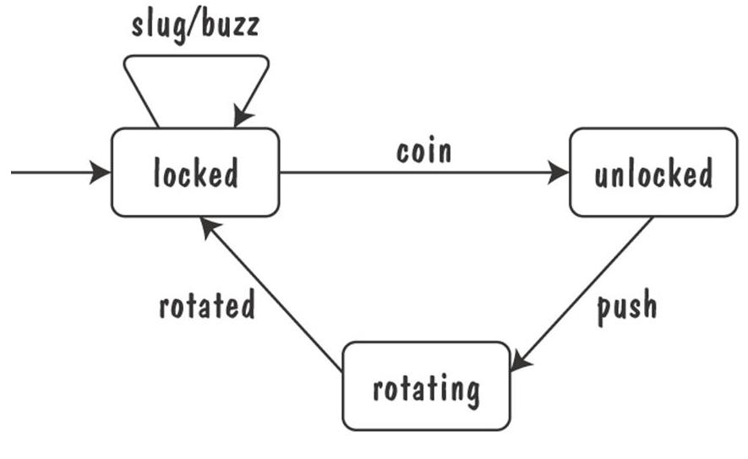
State Diagrams (Contd.)
Finite state machine model of the tunstile problem

Slide 36
State Diagrams (Contd.)
A path: starting from the machine's initial state and following transitions from state to state
A trace of observable events in the environment
Deterministic state machine: for every state and event there is a unique response

Slide 37
State Diagrams (Contd.)
Ways of thinking about State
Equivalence classes of possible future behavior
Periods of time between consecutive event
Named control points in an object's evolution
Partition of an object's behavior

Slide 38
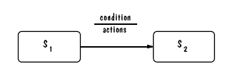
State Diagrams: UML Notation

Slide 39
State Diagrams: UML Statechart
A UML statechart diagram depicts the dynamic behaviour of the objects in a UML class
UML class diagram has no information about how the entities behave, how the behaviours change
A UML model is a collection of concurrently executing statecharts
UML statechart diagram have a rich syntax, including state hierarchy, concurrency, and inter-machine communication

Slide 40
UML Statechart Diagram
State hierarchy is used to unclutter diagrams by collecting into superstate those states with common transitions
A superstate can actually comprise multiple concurrent submachines, separated by dashed line
The submachines are said to operate concurrently
Students can recall the activity of reducing a DFA, or converting a DFA to a RE during Automata Course

Slide 41
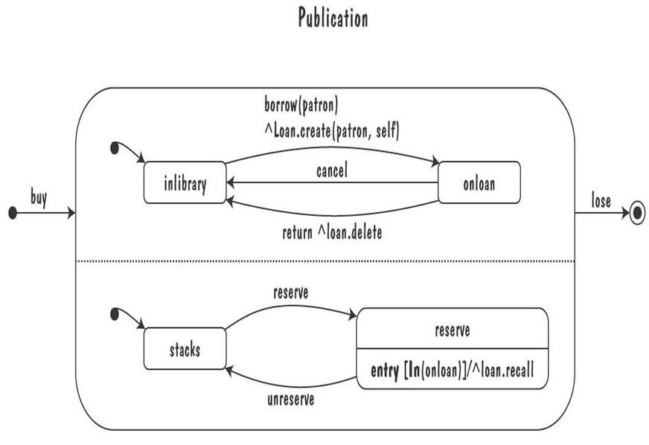
UML Statechart Diagram
The UML statechart diagram for the Publication class from the Library class model

Slide 42
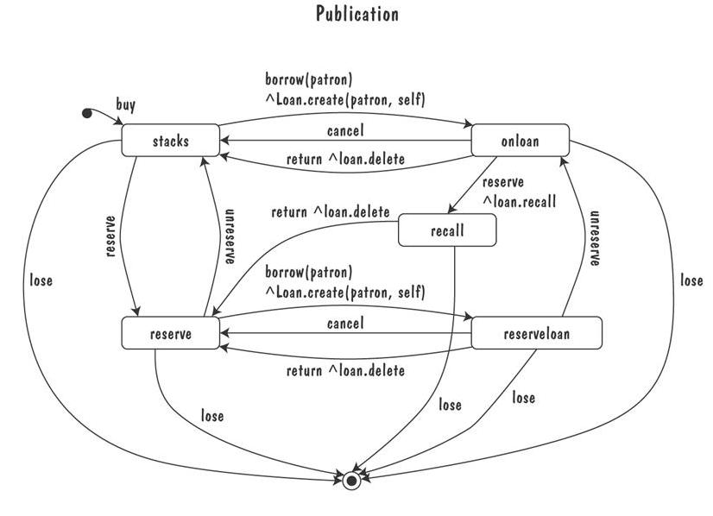
UML Statechart Diagram
An equivalent statechart for Publication class that does not make use of state hierarchy or concurrency
comparatively messy and and repetitive

Slide 43
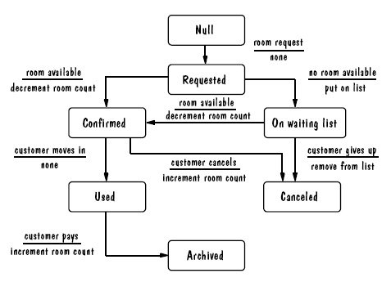
UML Statechart Diagram Example
The UML state diagram for Hotel Reservation

Slide 44
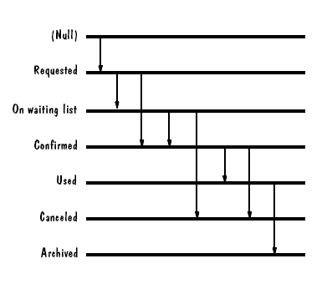
Fence Diagram

Slide 45
Lecture 10

Slide 47
Petri Nets
A form or state-transition notation that is used to model concurrent activities and their interaction
Circles (places) represent activities or conditions
Bars represents transitions
Arcs connect a transition with its input places and its output places
The places are populated with tokens, which act as enabling conditions for the transitions
Each arc can be assigned a weight that specifies how many tokens are removed from arc's input place, when the transition fires

Slide 48
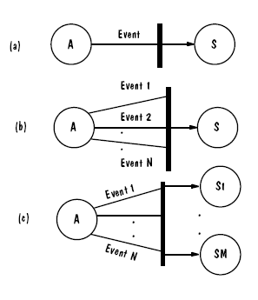
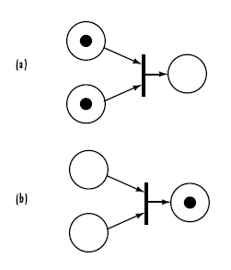
Petri Nets
Three types of transitions
Tokens

Slide 49
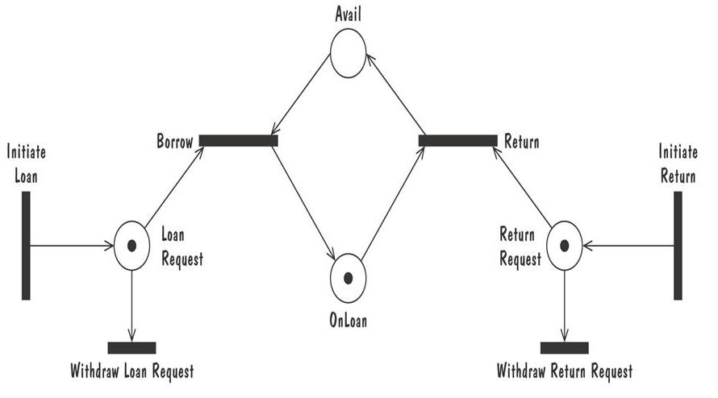
Petri Nets
Petri net of book loan

Slide 50
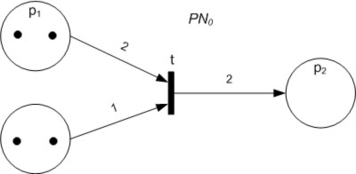

Slide 51
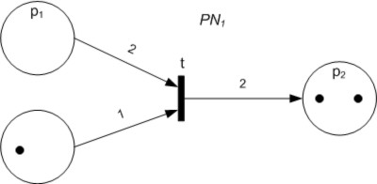

Slide 52
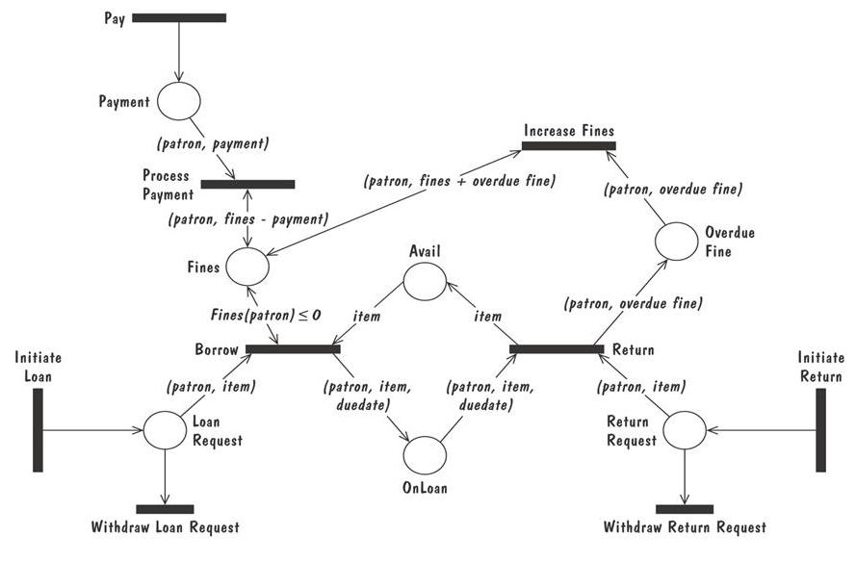
Petri Nets
A high level Petri net specification for the library problem

Slide 53
Event Traces
A graphical description of a sequence of events that are exchanged between real-world entities
Vertical line: the timeline of distinct entity, whose name appear at the top of the line
Horizontal line: an event or interaction between the two entities bounding the line
Time progresses from top to bottom
Each graph depicts a single trace, representing one of several possible behaviors
Traces have a semantic that is relatively precise, simple and easy to understand

Slide 54
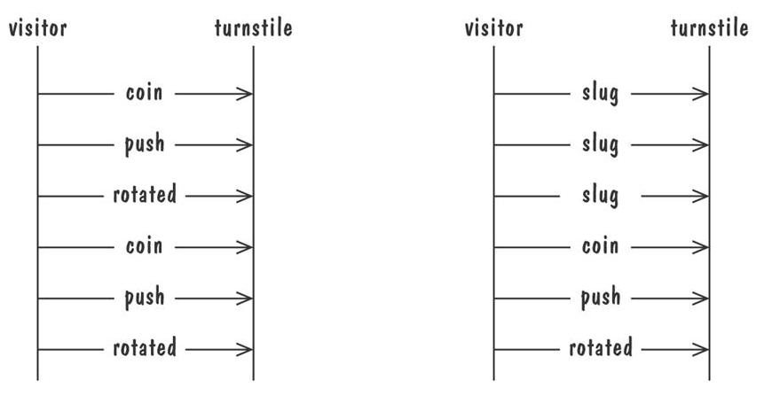
Event Traces
Graphical representation of two traces for the turnstile problem
trace on the left represents typical behavior
trace on the right shows exceptional behavior

Slide 55
Event Trace: example
Caller
Phone line
Callee
caller lifts receiver
dial tone begins
dials (2)
dial tone ends
dials (7)
dials (7)
dials (6)
ringing tone
phone rings
answers phone
phones connected
phones connected
callee hangs up
connection broken
connection broken
caller hangs up

Slide 56
Event Traces: Message Sequence Charts
An enhanced event-trace notation, with facilities for creating and destroying entities, specifiying actions and timers, and composing traces
Vertical line represents a participating entity
A message is depicted as an arrow from the sending entity to the receiving entity
Actions are specified as labeled rectangles positioned on an entity's execution line
Conditions are important states in an entity's evolution, represented as labeled hexagon

Slide 57
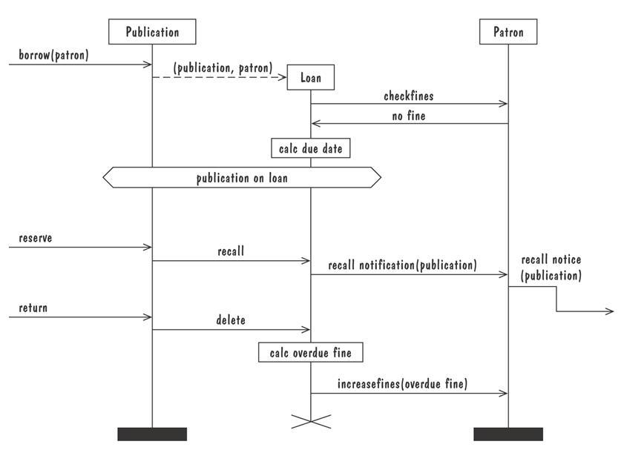
Event Traces: Message Sequence Charts
Message sequence chart for library loan transaction

Slide 58
Entity-Relationship Diagrams
A popular graphical notational paradigm for representing conceptual models
Has three core constructs
An entity: depicted as a rectangle, represents a collection of real-world objects that have common properties and behaviors
A relationship: depicted as an edge between two entities, with diamond in the middle of the edge specifying the type of relationship
An attribute: an annotation on an entity that describes data or properties associated with the entity

Slide 59
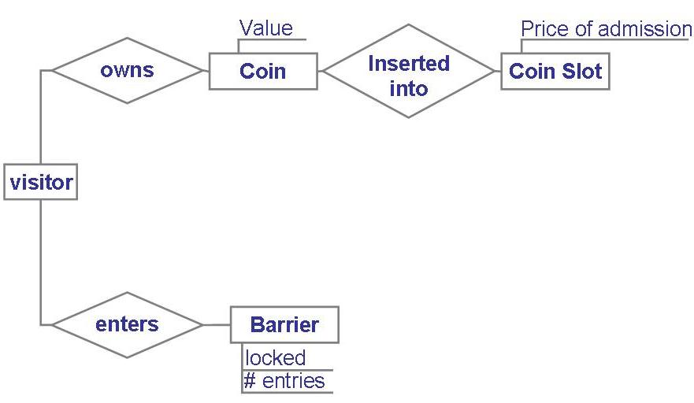
Entity-Relationship Diagrams
Entity diagram of turnstile problem

Slide 60
Entity-Relationship Diagrams
ER diagrams are popular because
they provide an overview of the problem to be addressed
the view is relatively stable when changes are made to the problem's requirements
ER diagram is likely to be used to model a problem early in the requirements process

Slide 61
Class Diagrams
UML (Unified Modeling Language) is a collection of notations used to document software specifications and designs
A Class Diagram represents a system in terms of
objects: akin to entities, organized in classes that have an inheritance hierarchy
attributes: object's variables or characteristics
methods: actions on the object's variables

Slide 62
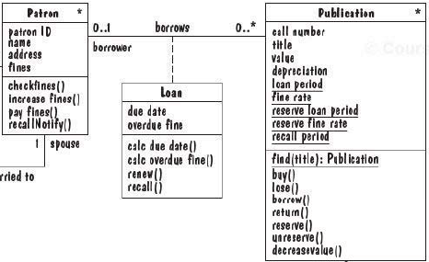
Class Diagrams
Association
Class Name
Class
Attributes
Methods

Slide 63
Lecture 11

Slide 64
Data Flow Diagrams (DFDs)
ER diagram, event trace, state machines depict only lower-level details
A data-flow diagram (DFD) models functionality and the flow of data from one function to another
A buble represents a process
An arrow represents data flow
A data store: a formal repository or database of information
Rectangles represent actors: entities that provide input data or receive the output result

Slide 65
Data flow models
A level 0 DFD, also called a fundamental system model or a context model, represents the entire software element as a single bubble with input and output data indicated by incoming and outgoing arrows.
Level 0 DFD refinement into level 1 DFD with all relevant processes to the system.
Level 1 DFD each processes can be refined into level 2 DFD.
Refinement of DFD continues until each bubble performs a simple function.

Slide 66
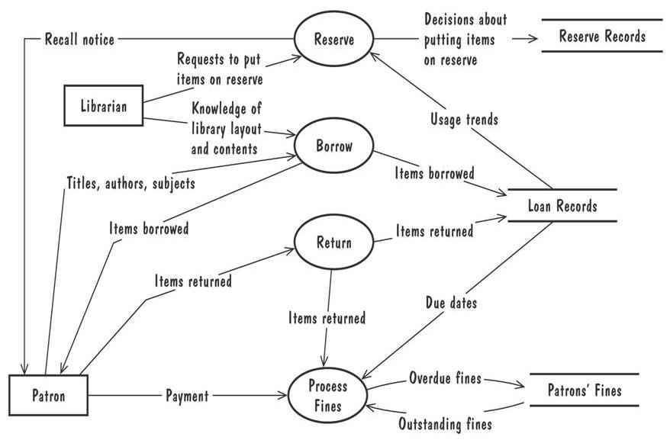
Data Flow Diagrams (Contd.)
A high-level data-flow diagram for the library problem

Slide 67
Data Flow Diagrams (Contd.)
Advantage:
Provides an intuitive model of a proposed system's high-level functionality and of the data dependencies among various processes
Disadvantage:
Can be aggravatingly ambiguous to a software developer who is less familiar with the problem being modeled

Slide 68
Use Case Diagram
Components
A large box: system boundary
Stick figures outside the box: actors, both human and systems
Each oval inside the box: a use case that represents some major required functionality and its variant
A line between an actor and use case: the actor participates in the use case
Use cases do not model all the tasks, instead they are used to specify user views of essential system behavior

Slide 69
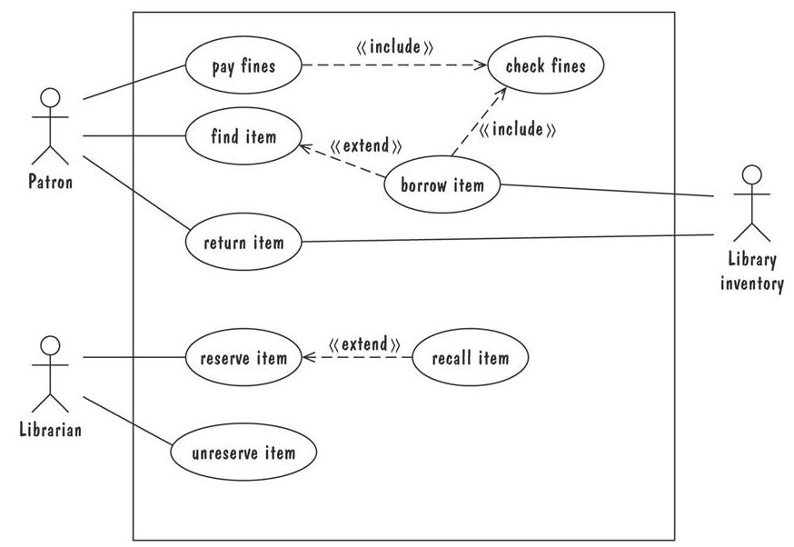
Use Case Diagram
Library use cases including borrowing a book, returning a borrowed book, and paying a library fine

Slide 70
Draw a use case diagram for ATM

Slide 71
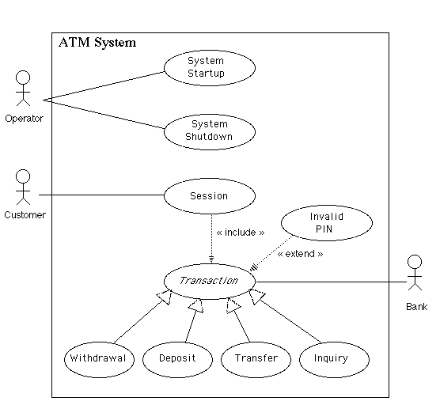

Slide 72
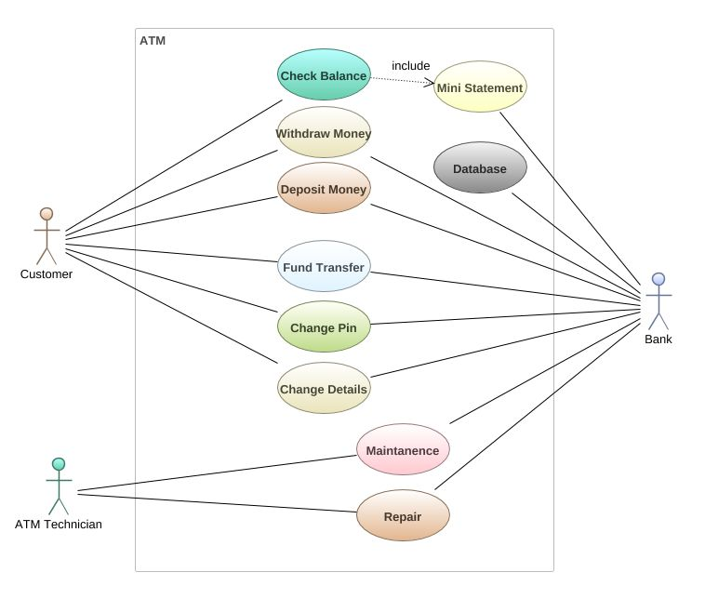

Slide 73
Writing Usecases
Mark Attendance Usecase

Slide 74
Prototyping Requirements
To elicit the details of proposed system
To solicit feedback from potential users about
what aspects they would like to see improve
which features are not so useful
what functionality is missing
Determine whether the customer's problem has a feasible solution
Assist in exploring options for optimizing quality requirements

Slide 75
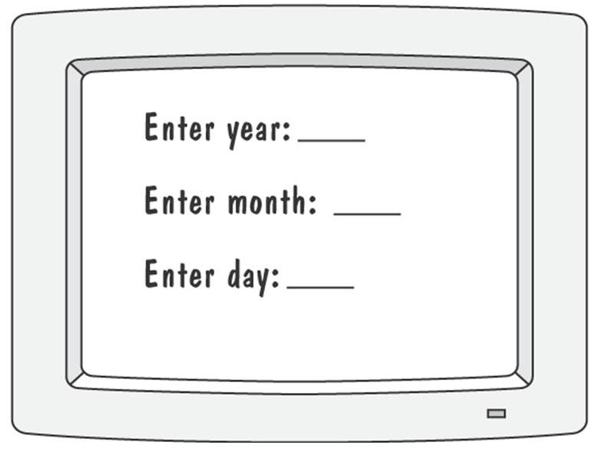
Prototyping Example
Prototype for building a tool to track how much a user exercises each day
Graphical respresentation of first prototype, in which the user must type the day, month and year

Slide 76
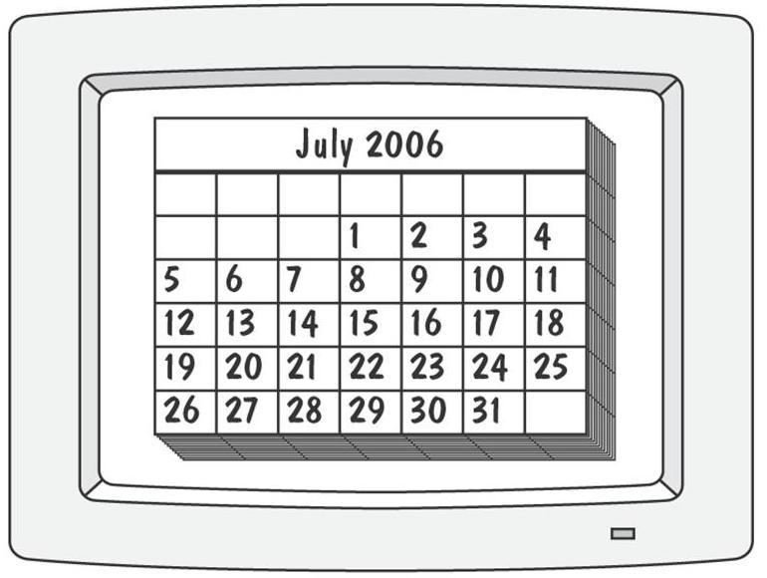
Prototyping Requirements
Second prototype shows a more interesting and sophisticated interface involving a calendar
User uses a mouse to select the month and year
The system displays the chart for that month, and the user selects the appropriate date in the chart

Slide 77
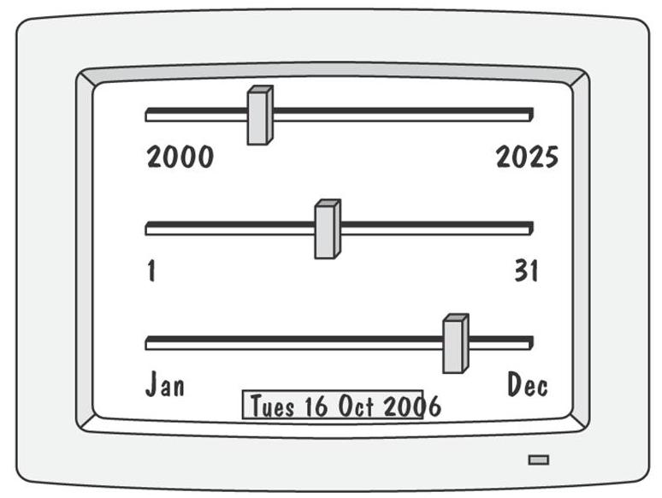
Prototyping Requirements
Third prototype shows that instead of calendar, the user is presented with three slide bars
User uses the mouse to slide each bar left or right
The box at the bottom of the screen changes to show the selected day, month, and year

Slide 78
Approaches to Prototyping
Throwaway approach
Developed to learn more about a problem or a proposed solution, and that is never intended to be part of the delivered software
Allow us to write “quick-and-dirty”
Evolutionary approach
Developed not only to help us answer questions but also to be incorporated into the final product
Prototype has to eventually exhibit the quality requirements of the final product, and these qualities cannot be retrofitted
Both techniques are sometimes called rapid prototyping

Slide 79
Prototyping vs Modelling
Prototyping
Good for answering questions about the user interfaces
Modelling
Quickly answer questions about constraints on the order in which events should occur, or about the synchronization of activities

Slide 80
Quiz

Slide 81
The critical path is ____ rout in the critical path management graph
Longest
Shortest
Average
None
all

Slide 82
All the tasks/milestones that lie on critical path have ___ slack time
1
2
3
4
all

Slide 83
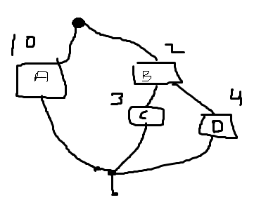
What is total time of this project
2
4
3
10
6
5

Slide 84
What is slack time of A
2
4
3
10
6
5

Slide 85
What is slack time of B
2
4
3
10
6
5

Slide 86
What is slack time of C
2
4
3
10
6
5

Slide 87
What is slack time of D
2
4
3
10
6
5

Slide 88
Quiz

Slide 89
Human can be super class of student or employee. The concept is called
Generalization
Inheritance
Composition
Association
Aggregation
All
none

Slide 90
student or employee can be sub class of human. The concept is called
Generalization
Inheritance
Composition
Association
Aggregation
All
none

Slide 91
A person can not donate his lungs after death, the relationship between person and lungs is
Generalization
Inheritance
Composition
Association
Aggregation
All
none

Slide 92
A person can donate his eyes after death, the relationship between person and eyes is
Generalization
Inheritance
Composition
Association
Aggregation
All
none

Slide 93
Student object interacts with teacher, the relationship is called
Generalization
Inheritance
Composition
Association
Aggregation
All
none

Slide 94
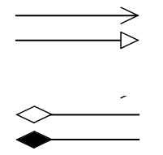
Describe the symbols

Slide 95
Describe the symbols

Slide 96
Describe the symbols

Slide 97
Describe the symbols

Slide 98
Following NFA/DFA

Slide 99
Following NFA/DFA

Slide 100
Following NFA/DFA

Slide 101
Customer needs a high speed software
Testable
Not testable

Slide 102
Customer needs a memory efficient software
Testable
Not testable

Slide 103
Customer needs a software having response time less 1 second
Testable
Not testable

Slide 104
Customer needs a software having memory usage less than 1 mb
Testable
Not testable

Slide 105
If there are four fields and each field has two options. The decision table will have ________ rules
12
13
14
15
16
17
18

Slide 106
If there are three classes in your class diagram. How many state diagrams will you draw
1
2
3
4
5
6

Slide 107
In ERD, the ___ refer to the entities
Verbs
Adjectives
Nouns
Articles
actor

Slide 108
In DFD, the rectangle refers to
Process
Storage
Entities
Use case
actor

Slide 109
In DFD, the circle refers to
Process
Storage
Entities
Use case
actor

Slide 110
In use case diagram, the person symbol refers to
Process
Storage
Entities
Use case
actor

Slide 111
In use case diagram, the oval symbol refers to
Process
Storage
Entities
Use case
actor

Slide 112
References
Pfleeger Book slides from UCF
Disclaimer!
A few slides have been reused from UCF slides for the SE course

